Slide 1
The Power of Project Leadership
Seven leadership lessons – a personal journey
Svenskt Projektforum
30th May 2017
7A Odenplan Stockholm
30th May 2017
Paul Hodgkins
Executive Director
Paul Hodgkins Project Consultancy Limited

Slide 2



Leadership – some questions to think about
Who do we think of as being a great leader?
      What qualities do we believe great leaders demonstrate?
Are leaders born or are leaders made?
Achieved in Q – FY 10/11
Expected in Q2 – FY10/11
Information & Action

Slide 3

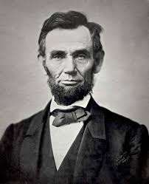
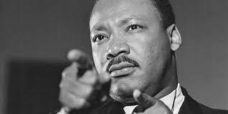
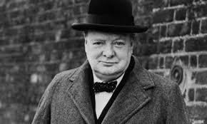
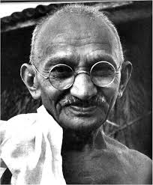
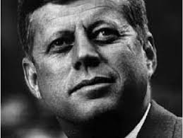
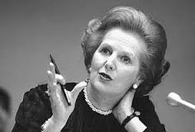
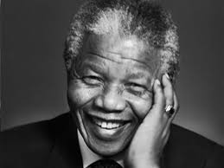
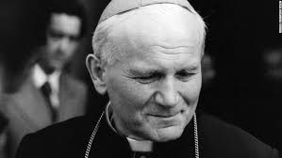
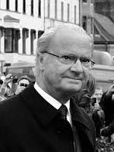
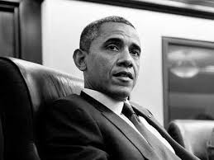
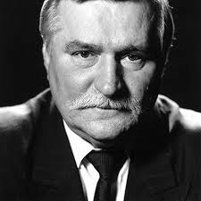
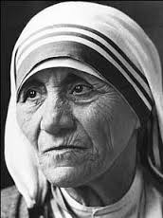

The Power of Project Leadership

Slide 4
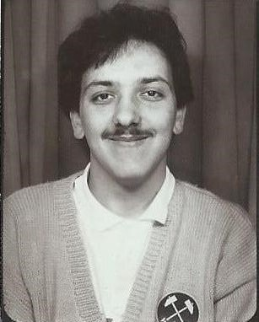
Presentation Topics
Achieved in Q – FY 10/11
Expected in Q2 – FY10/11
Information & Action

Slide 5
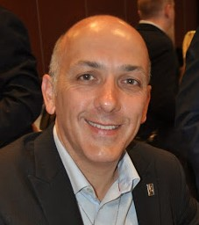
Presentation Topics
Achieved in Q – FY 10/11
Expected in Q2 – FY10/11
Information & Action
33 years

Slide 6



Seven leadership lessons – a personal journey
Lesson No.1
Achieved in Q – FY 10/11
Expected in Q2 – FY10/11
Information & Action

Slide 7

‘Seven leadership lessons – a personal journey’
  Earn the right to lead
    Leadership is not a position or title; it is action and example
    Do what you say you will do, when you said you would do it and the way you said you would do it – your behaviour must be in line with your words!
    Build trust and mutual respect
    Empower your project teams so that they can empower themselves

Slide 8

Seven leadership lessons – a personal journey
Lesson No.1
“Leadership cannot be given, it must be earned. It cannot be taken away, but it can be lost”

Slide 9



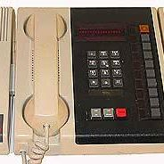

Seven leadership lessons – a personal journey
Lesson No.2
2. Be Authentic
When what you think, feel, say and do are in harmony
Be yourself, be true to your values, know your purpose and the project’s purpose – ask why, not what
If you try to be someone you are not, you may find you end up being dressed for the wrong occasion
Expected in Q2 – FY10/11

Slide 10
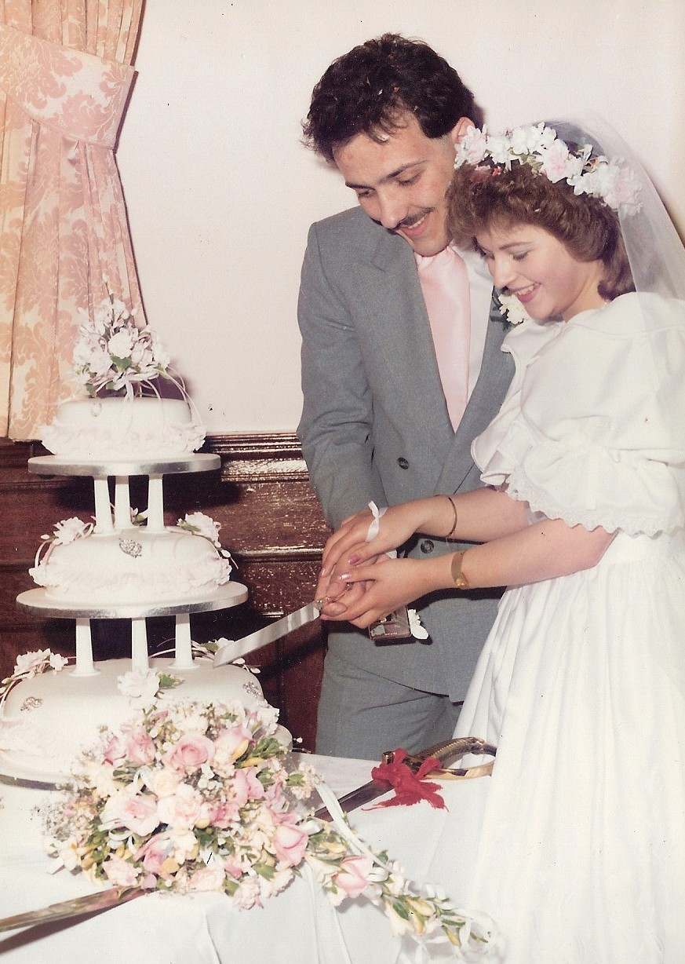

Seven leadership lessons – a personal journey
Lesson No.3
3. Vision
Creating a vision of what you and the project can become
Help your team to see the bigger goal and the importance of their role
Show the way, lead the way and then get out of the way
Achieved in Q – FY 10/11

Slide 11
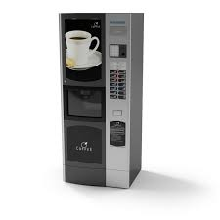

Seven leadership lessons – a personal journey
Lesson No.4
4. Leading ‘left and right’
Leadership is influence and influence is leadership……even if either lasts only for a moment in time
Leadership is what is around you, not only what is above or below!
Make sure you are leading your teams ‘left and right’ not only ‘up and down’
Achieved in Q – FY 10/11

Slide 12

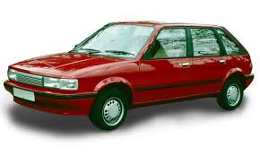
Seven leadership lessons – a personal journey
Lesson No.5
5. Persistently Passionate
Work with intent and enjoyment; if you don’t enjoy what you do, or the responsibility you have, then why are you doing it?
You can not be passionate about something you don’t care about
Achieved in Q – FY 10/11

Slide 13

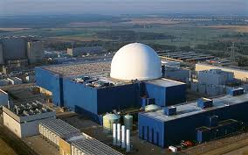


Seven leadership lessons – a personal journey
Lesson No.6
6. Anticipation
Observe, adapt and learn from good, bad and everything in between
Anticipate what could happen instead of what has happened – think about the next set of challenges, behaviours and likely reactions
Be in control, rather than being controlled
Achieved in Q – FY 10/11

Slide 14
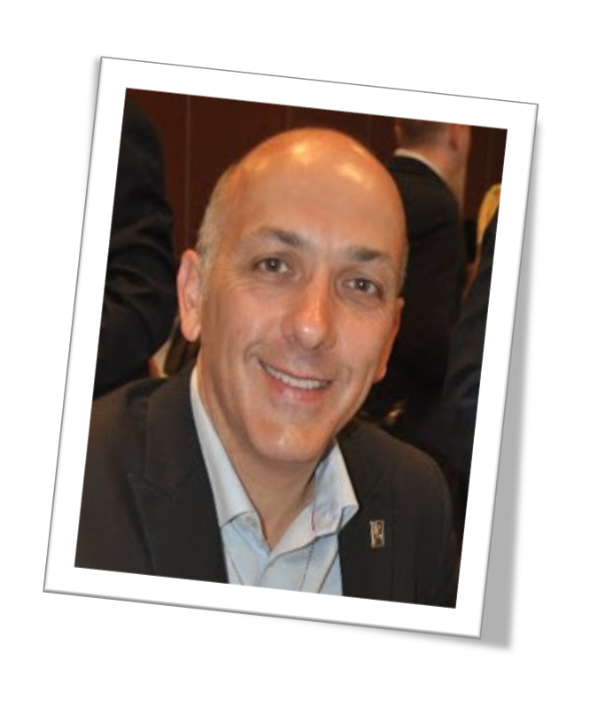

Seven leadership lessons – a personal journey
Lesson No.7
7. Passing the Ball
There will be situations in the project when you are not the right person to lead – that is not an admission of failed leadership
When you delegate, you are taking responsibility – not giving it away
Telling your team you depend on them and meaning it, is the best way for your team to know you are dependable
Achieved in Q – FY 10/11

Slide 15

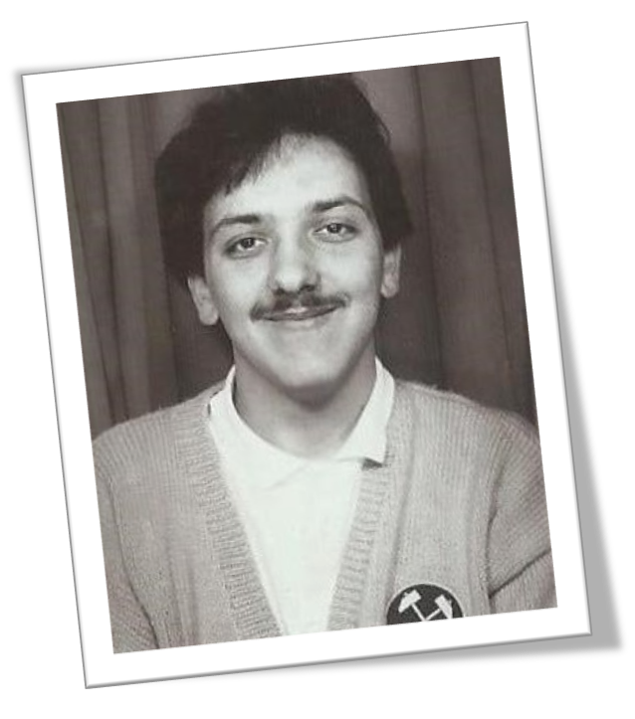
‘Seven leadership lessons – a personal journey’
  Earn the right to lead
  Be Authentic
  Vision and Vista
  Leading ‘left and right’
  Persistently Passionate
  Anticipation
  Passing the Ball
Expected in Q2 – FY10/11
Information & Action

Slide 16

The Power of Project Leadership
Seven leadership lessons – a personal journey
Tack för att du lyssnar
Paul Hodgkins Project Consultancy
www.paulhodgkins.com
Email: paul.hodgkins3@btinternet.com
https://uk.linkedin.com/in/paulhodgkins
Tel: +44 (0)7730 350422

